Slide 1


Sleep Deprivation Of The Senior High School Learners

Slide 2


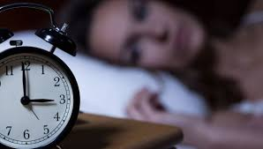
Occurence

Slide 3
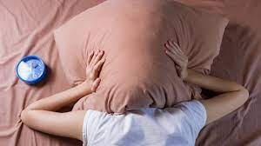
They tend to
“kill their sleep"

Slide 4
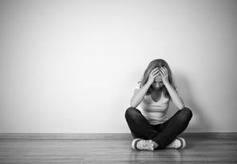


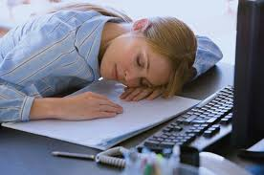
Effects

Slide 5



Dependence on

Slide 6
Background of the Study
Sleep deprivation affects diverse facets of intellectual and psychological functioning; minor alterations in sleep span may result in learners’ cognitive and behavioral deficiencies. Sleep is paramount for learners’ mental restoration; they need to have at least eight hours a night to fully obtain the full cognitive function to do their academic studies sufficiently. It impacts how knowledge is acquired, how they study, and how they retain their memory. The occurrence of sleep deprivation is pervasive among senior high school students spend multiple restless nights. Due to overburdened academics, work duties, and mental health concerns, they tend to “kill their sleep" by doing certain activities and using substances to remain open-eyed. Lack of sleep can lead to unproductivity and more significant distress in learners. Poor sleep could substantially influence a person's physiological health, emotional well-being, and academic performance over time. Therefore, this research strives to scrutinize and determine how sleep deprivation affects learners’ health and academic performance.

Slide 7

Statement of the Problem
This study aims to ascertain the acknowledgment and identity the impact of sleep deprivation on the academic performance in Abanon National High School Senior High students.

Slide 8
Objective
Awareness of Sleep deprivation
Analyzing and observe to make a possible solution.
Evaluate the causes and effects of sleep deprivation that can affect their academic performance of senior high school students.

Slide 9
Chapter ll
Review of Related Literature and Studies

Slide 10
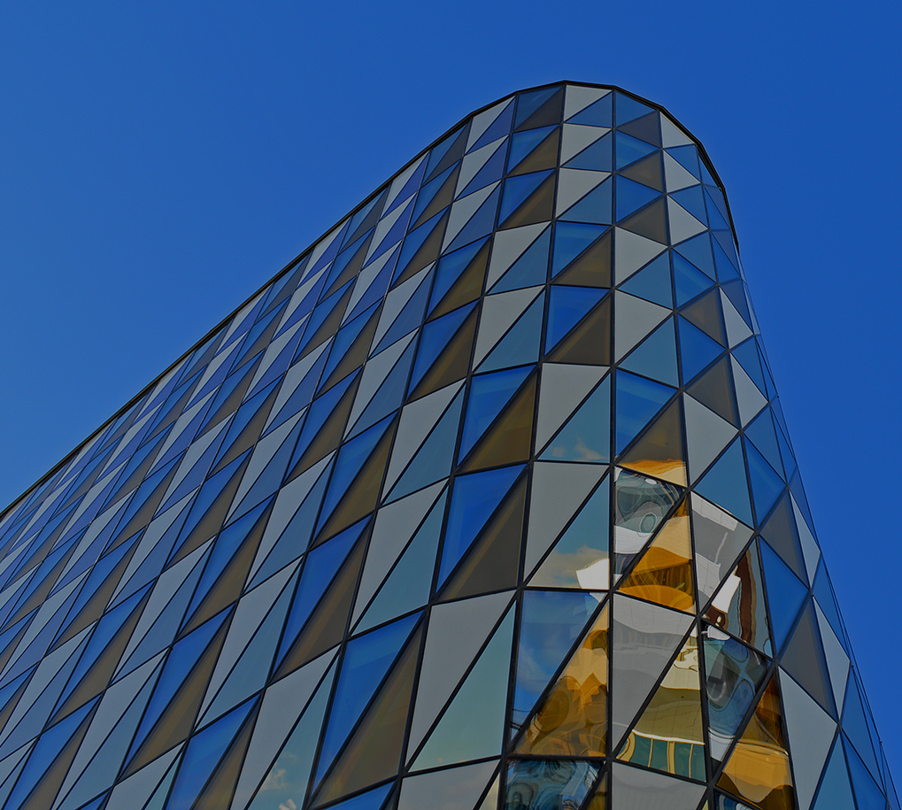
Foreign Literature
Mental health problems can affect individuals' sleep in different ways. Anxiety can cause their thoughts to race, making it hard to sleep. Depression can lead to oversleeping: sleeping late or sleeping a lot during the day.

Slide 11
Local Literature
The discussion of total sleep deprivation effects on performance has been centered on two basic cognitive processes: attention and executive functions.
On one hand, studies propose that total sleep deprivation primarily affects attention, while executive functions remain preserved. Therefore, people can respond to demanding situations, but they have trouble responding efficiently to monotonous tasks, due to attention deficiencies.
On the other hand, different studies discuss that sleep deprived people can perform simple tasks, but they have difficulties to accomplish complex tasks, in which executive functions are implicated.

Slide 12
Theoritical framework
Restoration Theory by Oswald, (1966) is a theory that discusses sleep. It stated and explained the essence of sleep to a human being. In accordance with the theory, sleep functioned by restoring the vitality of our human body and the vitality of our brain.
Hibernation Theory by Webb, (1974) is part of the evolutionary theories of sleep. This theory discusses the impact of sleep on a human’s body and behavior. According to it, sleep evolved because it was forced to conserve energy.
This chapter presents different theories as theoretical foundations to support the ideologies of this research paper. This will also strengthen the objectives and primary purpose of this study to make it more prominent.
Brain Plasticity Theory by James, (1890) is a psychological theory. It explained that neuroplasticity response to learning and experience is through changes and adaptation in the structure and function of the brain’s capacity.

Slide 13
Conceptual Framework
People lives during the pandemic had utterly changed, particularly the young ones. Students are in a new normal situation where they face gadgets to learn instead of listening to their perspective teacher without facing their phones or laptops. Hence, they cannot utterly comprehend and might feel pressure. It drives them to do their tasks eager and without proper time management. There are also productive tasks in their household that they should do, depriving their time and sleep. Since this situation is new for them, students are certainly still children, and it is unhealthy for them to have insufficient sleep at a young age. It is a struggle for them to cope-up, which would negatively impact their academic
performances.
As a schematic diagram, figure A will show the illustration of the interplay of the dependent and independent variables and the output of the study. The independent variables will show the profile of the respondents: Which obtain the age, gender, grade level, and economic status of the respondents. Also, in the following column, they have the dependent variable, mainly focusing on Senior High School students’ academic performance. Moreover, lastly, the output of the study, which they intend to employ in awareness programs to educate and give awareness to both students who have experienced sleep deprivation and those who have.

Slide 14
CHAPTER lll
METHODOLOGY
This chapter presents the method and procedure used in this study. It also discusses the following sub-headings: research design, research environment, respondents, and data gathering procedure, research instruments, their validity, and the statistical treatment of the data.

Slide 15
Research Design
This study will utilize a quantitative research method. This research will use the descriptive correlational research design. Descriptive correlational studies describe the variables and the relationships that occur naturally between and among them. This research design will help the study about Sleep Deprivation: Its Causes and Effects to the Academic Performance of the Senior High School Learners in Abanon National High School.

Slide 16
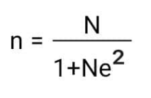
Population and Sampling
The study focuses on the cause and effects of Sleep Deprivation in Grade 11 Students to Grade 12 Students. A stratified random sampling was used in this study for the selected respondents. The total number of grade 11 and Grade 12 Students to get appropriate of the participants. It is important that the total number of samples is determined by using:
Slovin's Formula
Where:
n= sample size
N= total no. Grade 11 & 12 students
e= margin of error (0.10)
n=2461+246(.10)2
n=2461+246(.01)
n=71

Slide 17
And to know the respondent's in each grade level, the respondent's will be selected through stratified sampling which method where the total population is divided into smaller groups or strata to complete the sampling process.
Population of Subgroups
Stratified
Random =
Sampling
x Total Sample Size
Entire Population

Slide 18
Instruments and Data Collection
To acquire the data for the fulfillment of the study, the researchers will amass data from books, journals, and online references correlated to the study. The researchers will also develop a questionnaire through a review of literature initially; it will undergo approval from at least 2 professionals. The researchers will also seek permission from the Abanon Senior High School department to distribute the questionnaires to the subjects who belong to the stated department

Slide 19
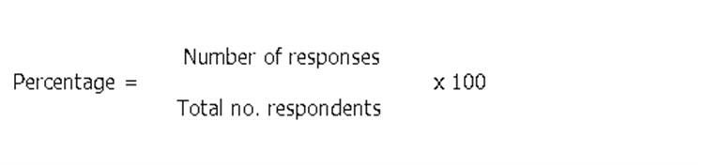
Data Analysis Tools
The data that will be gathered by the researcher from the responses of students will be tallied, tabulated, and presented in tabular form. The data will be analyzed and interpreted through the use of the following statistical tools:
Where:

Slide 20
Chapter lV
PRESENTATION , ANALYSIS AND INTERPRETATION OF DATA

Slide 21
Findings
This chapter reports the analysis of data collection from a sample of 71 students who selected no. of respondents in defferent strands from grade 11 and 12 who agreed to participate in the study. The first part of this chapter presents descriptive demographic information about the sample obtain in the survey.This demographic information is the student’s backgrounds using percentage.

Slide 22
Part I. Profile of the respondents
The profile of the respondents in terms of Age, Gender,Grade level and Strand are listed below:
Table 1.1 .Presentation of Age of Grade 11 and 12 respondents
Age | Percentage
15 | ------
16 -17 | 80.3%
18 - 19 | 19.7%
20 | -------
Above 20 | -------

Slide 23
Part I. Profile of the respondents
Table 1.2 Presentation of Gender of Grade 11 and 12 respondents
Gender | Percentage
Male | 59.2%
Female | 40.8%
Table 1.3 Presentation of Grade level of Grade 11 and 12 respondents
Grade level | Percentage
11 | 66.2%
12 | 33.8%

Slide 24
Part I. Profile of the respondents
Table 1.4 Presentation of Strand of Grade 11 and 12 respondents
Strand | Percentage
STEM | 12.7%
HUMSS | 36.6%
GAS | 29.6%
ICT/BC | 12.7%
ABM | 8.5%

Slide 25
Part II. Sleep Deprivation
It’s Causes and Affects to the Academic Performance Of the Senior High School Learners
Rating Scale | Interval Scale | Descriptive Equavalent
4 | 4.00 - 3.00 | Strongly Agree
3 | 2.99 - 2.00 | Agree
2 | 1.99 – 1.00 | Disagree
1 | 1.00 – 0.99 | Strongly Disagree

Slide 26
Part III. Causes of sleep Deprivation
A. Exposure to Gadgets
Questions | 4 | 3 | 2 | 1 | Weighted Mean |  | Descriptive Equivalent
I use electronic gadgets before I sleep | 16 | 52 | 3 | 0 | 3.18 |  | SA
I use electronic devices for more than 3 hour a day | 22 | 44 | 4 | 1 | 3.22 |  | SA
I have trouble falling asleep when using my phone. | 18 | 34 | 17 | 2 | 2.95 |  | A
I don’t have adequate sleep because I am always on my phone | 10 | 26 | 34 | 1 | 2.63 |  | A
I experience sleep disturbances due to my phone | 16 | 36 | 19 | 0 | 2.95 |  | A
Average Weighted Mean |  |  |  |  |  | 2.98 | A

Slide 27
Part III. Causes of sleep Deprivation
B. Mental Health Issues
 | Rating Scale
Questions | 4 | 3 | 2 | 1 | Weighted Mean | Descriptive Equivalent
I cannot fall asleep with ease because of overthinking | 15 | 40 | 16 | 0 | 2.98 | A
I experience sleep disruptions because of nightmares. | 16 | 30 | 24 | 1 | 2.85 | A
I find difficult to sleep due to panic attacks | 4 | 32 | 34 | 1 | 2.54 | A
I feel anxious before going to sleep due to my negative thoughts | 16 | 32 | 21 | 2 | 2.87 | A
I find it hard to sleep because of depression | 9 | 34 | 27 | 1 | 2.73 | A
Average Weighted Mean |  |  |  |  | 2.79 |  | A

Slide 28
Part III. Causes of sleep Deprivation
C.Work Obligation
 | Rating Scale
Questions | 4 | 3 | 2 | 1 | Weighted Mean |  | Descriptive Equivalent
I sleep late due to meeting assignments deadlines | 25 | 42 | 4 | 0 | 3.29 |  | SA
I can’t handle my time management due to a lot of house works | 24 | 36 | 10 | 1 | 3.16 |  | SA
I sleep late , assisting my family to prepare for our business | 5 | 36 | 28 | 2 | 2.61 |  | A
Do my work at night because the daytime is not enough for me to finish my obligations as a student and as part of our household | 20 | 39 | 10 | 2 | 3.08 |  | SA
I cant focus on doing my school works in the daytime | 10 | 40 | 19 | 2 | 2.81 |  | A
Average Weighted Mean |  |  |  |  |  | 2.99 | A

Slide 29
Part IV. Effects of sleep Deprivation
D. Psychological Risk
 | Rating Scale
Questions | 4 | 3 | 2 | 1 | Weighted Mean |  | Descriptive Equivalent
I usually experience mood swings if I’m sleep - deprived | 11 | 41 | 18 | 1 | 2.87 |  | A
I’m easily irritable when I don’t have a night of adequate sleep | 17 | 37 | 16 | 1 | 2.98 |  | A
I find it hard to cope with stress if I don’t have a night of sufficient sleep | 12 | 37 | 22 | 0 | 2.85 |  | A
My anxiety levels exacerbate if I don’t sleep enought | 8 | 37 | 22 | 4 | 2.69 |  | A
I easily forget things if I’m sleep - deprived | 12 | 37 | 22 | 0 | 2.85 |  | A
Average Weighted Mean |  |  |  |  | 2.84 | A

Slide 30
Part IV. Effects of sleep Deprivation
E.Physiological Health
 | Rating Scale
Questions | 4 | 3 | 2 | 1 | Weighted Mean | Descriptive Equivalent
I experience muscle tremors if didn’t have enough sleep | 8 | 34 | 24 | 5 | 2.63 | A
I experience body aches after having inadequate sleep | 16 | 36 | 18 | 1 | 2.94 | A
I experience fatique during the daytime due to lack of sleep | 18 | 32 | 20 | 1 | 2.94 | A
I have a headache after I don’t sleep sufficiently | 18 | 42 | 10 | 1 | 3.08 | SA
I have experience anemia when I don’t have enough sleep | 10 | 39 | 19 | 3 | 2.78 | A
Average Weighted Mean |  |  |  |  | 2.87 | A

Slide 31
Part IV. Effects of sleep Deprivation
F.Social Interaction
 | Rating Scale
Questions | 4 | 3 | 2 | 1 | Weighted Mean |  |  | Descriptive Equivalent
I don’t enjoy interacting with other people when I’m sleep- deprived | 12 | 32 | 26 | 1 | 2.77 |  |  | A
It is hard for me to efficiently recognize someone’s emotions if I don’t have enough sleep | 18 | 26 | 26 | 1 | 2.85 |  |  | A
I avoid close contact with other people if I’m sleep – deprived | 14 | 27 | 27 | 3 | 2.73 |  |  | A
I feel lonelier when I’m sleep deprived | 13 | 28 | 27 | 3 | 2.69 |  |  | A
I feel unconfident if I’m sleep - deprived | 17 | 30 | 22 | 2 | 2.87 |  |  | A
Average Weighted Mean |  |  |  |  |  | 2.78 | A

Slide 32
Chapter V
Summary , Conclusions and Recommendations

Slide 33
Summary
This study aims to ascertain the acknowledgment and identity the impact of sleep deprivation on the academic performance in Abanon National High School Senior High students. Primarily this will aim to answer the following questions:
1.What is the demographic profile of respondents in terms of;
Age
Gender
Grade level
1.4 Strand
2. What is the causes of sleep deprivation in terms of
2.1. exposure to gadgets;
2.2. mental health issues; and
2.3. work obligations?
3.What is the effects of sleep deprivation in terms of;
3.1. psychological risk;
3.2. physiological health; and
3.3. social interaction
4.What are the common sleep deprivation symptoms experienced by the students ?
5. Is there a significant relationship between the causes of sleep deprivation to the students?
6.Is there a significant relationship between the effects of sleep deprivation on the students ?
7.What could be the possible awareness to prevent developing sleep deprivation in students ?

Slide 34
Conclusions
There are various causes of sleep deprivation, which can be voluntary behavior, personal obligations, working schedule, or medical problems. it shows that exposure to gadgets is one of the cause of sleep deprivation due to boredness and addicted to gadgets they didn't noticed the time they spend a lot and they forgot to eat their foods and in trouble to falling asleep when using phone furthermore because of overuse and they have no limitation. The mental health issues can lead iInsufficient sleep negatively affects the nervous system, resulting in poor brain function. Because of the cognitive decline that is associated with sleep deprivation, academic performance is often decreased. Work obligation is the number one of causes of sleep deprivation and have a big impact of their academic performance and it have more difficulty concentrating, learning, and communicating.

Slide 35
Recommendations
From the results from the findings in the Sleep Deprivation : It’s Causes and Affects to the Academic Performance Of the Senior High School Learners. We suggest the following solutions to address the phenomena.
1. Using gadgets much better to have a knowledge and understanding on how to limit their self on proper way of using it to prevent to much exposure to gadgets. Using it in purposive way to their studies to improve
academic performance.
2. Grade 11 and 12 Learners in Abanon Senior High School are recommended to improve their study habits for them to perform well Academically.
3. Grade 11 and 12 Learners who have less sleep per night due to their Exposure to Gadgets, Mental Health Issues, Work Obligations suggested to improve their sleep hygiene in order for them to attain the adequate sleep appropriate for their developing body and mind.
4. Grade 11 and 12 Learners are encouraged to get regular exercise and proper nutrition; there are many cases doing exercise late at night may help them focus on sleep because the body needs to rest as soon as possible. Also, having a proper diet may help to fight insomnia.

Slide 36
Recommendations
From the results from the findings in the Sleep Deprivation : It’s Causes and Affects to the Academic Performance Of the Senior High School Learners. We suggest the following solutions to address the phenomena.
5. Grade 11 and 12 Learners must avoid staying up all night by surfing the internet or playing games on a screen and avoid napping during the day since it may cause them to be wakeful at night.
6. Grade 11 and 12 Learners should plan out their schedules from their perspective so that they control their time. Also, taking notes or making an outline when they have a lot of house works to finish their obligations as a student and as part of their household may help them with their assigned task or activities.
7. Grade 11 and 12 Learners are highly encouraged to assess their learning style as it may help them develop strategies which will enhance their learning potential and evaluate the method they prefer to study or process information. Furthermore, taking breaks—without any screens—while studying may help the students to refresh their minds.
8. Studying in a quiet environment may help the grade 11 and 12 learners to study peacefully and be more focused. Also, using several study techniques may help them improve as well.

Slide 37

THANK YOU!
Phone
0916 455 2569
Email
lloydalexis484@gmail.com
Lloyd Alexis Camacho
Mark Gil Garcia
French Ashley Cancino
April Anne Vinoya
Ronaldo Alcantara
Renier Medina
Kyla Cabuang
Rochelle Aquino Gutierrez
Raymundo Ramos
Janelle Sales

